Slide 1
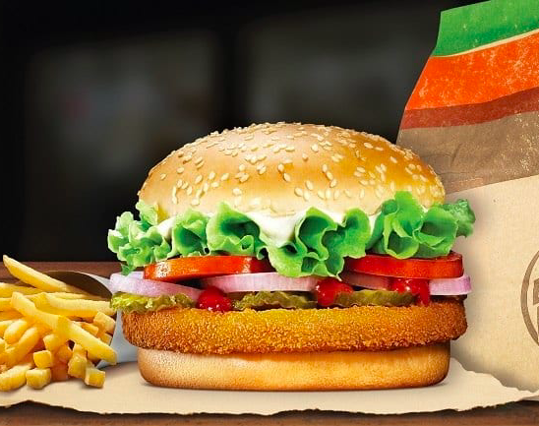
Burger King Nutrition Analysis
A Data-Driven Approach to Healthier Choices

Slide 2
Data Overview
Dataset Source & Structure
Total Items: 150+ menu items
Key attributes: Calories, Fat, Protein, Carbs, Sodium, etc.
Data Cleaning Process: Removed duplicates, handled missing values, corrected inconsistencies

Slide 3
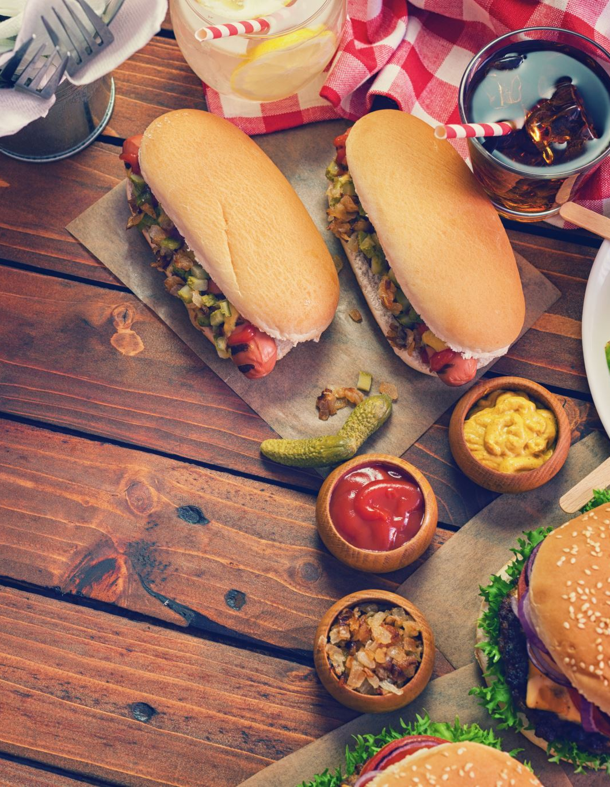
Health Score Rankings
Calculating using Higher protein, fiber, fat & sugars
Higher protein & fiber = Healthier Higher fat & sugars = Less healthy
Triple WHOPPER Sandwich with Cheese ( Healthiest Item in menu) with High protein content, good fiber balance.
Bara's Root Beer (38 fl oz) ( Least Healthy Item ) with Extremely high sugar, zero fiber & protein

Slide 4
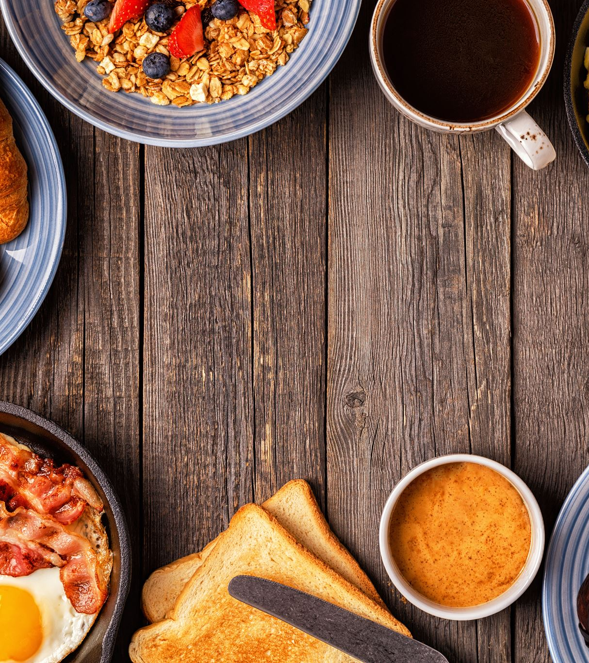
Balanced Meal Analysis
Meals with equal fat, protein, and carbs
Beverages like Unsweetened Tea & Black Coffee had zero calories, fat, and carbs

Slide 5
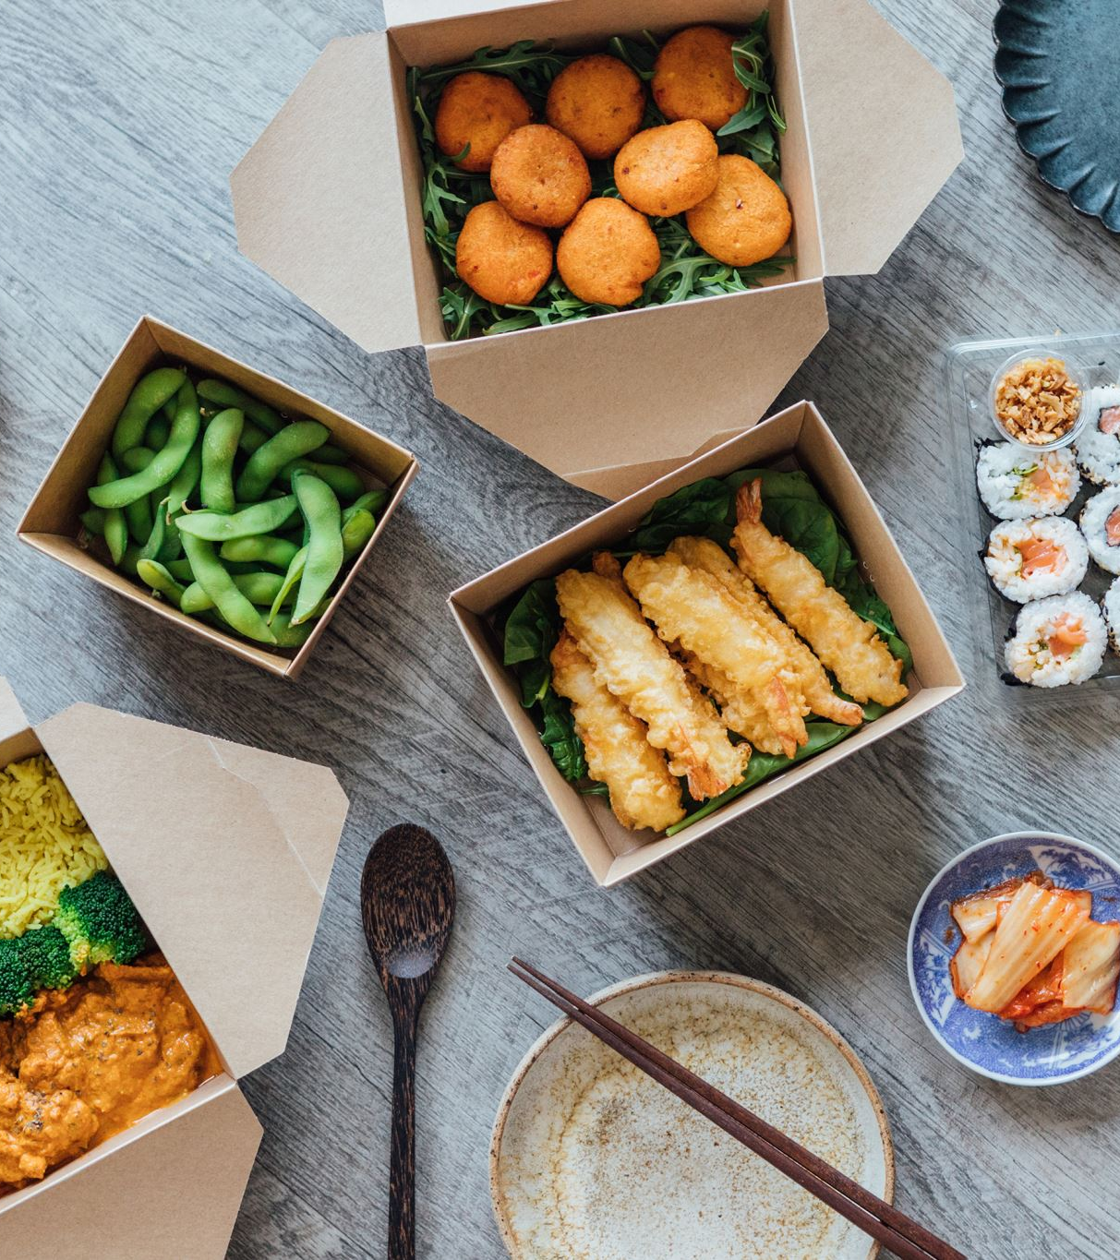
High-Protein, Low-Carb Options
Best Choices for Low-Carb Dieters:
Chicken Nuggets (4pc, 6pc)
Garden Side Salad (High Protein, Low Carb)

Slide 6
Sodium Content Analysis
Heart-Healthy Options (Lowest Sodium):
BK Cafe Coffee
Unsweetened Tea
Simply Orange Juice
High Sodium Alert:
Ham, Egg & Cheese Biscuit (1610 mg sodium!)

Slide 7
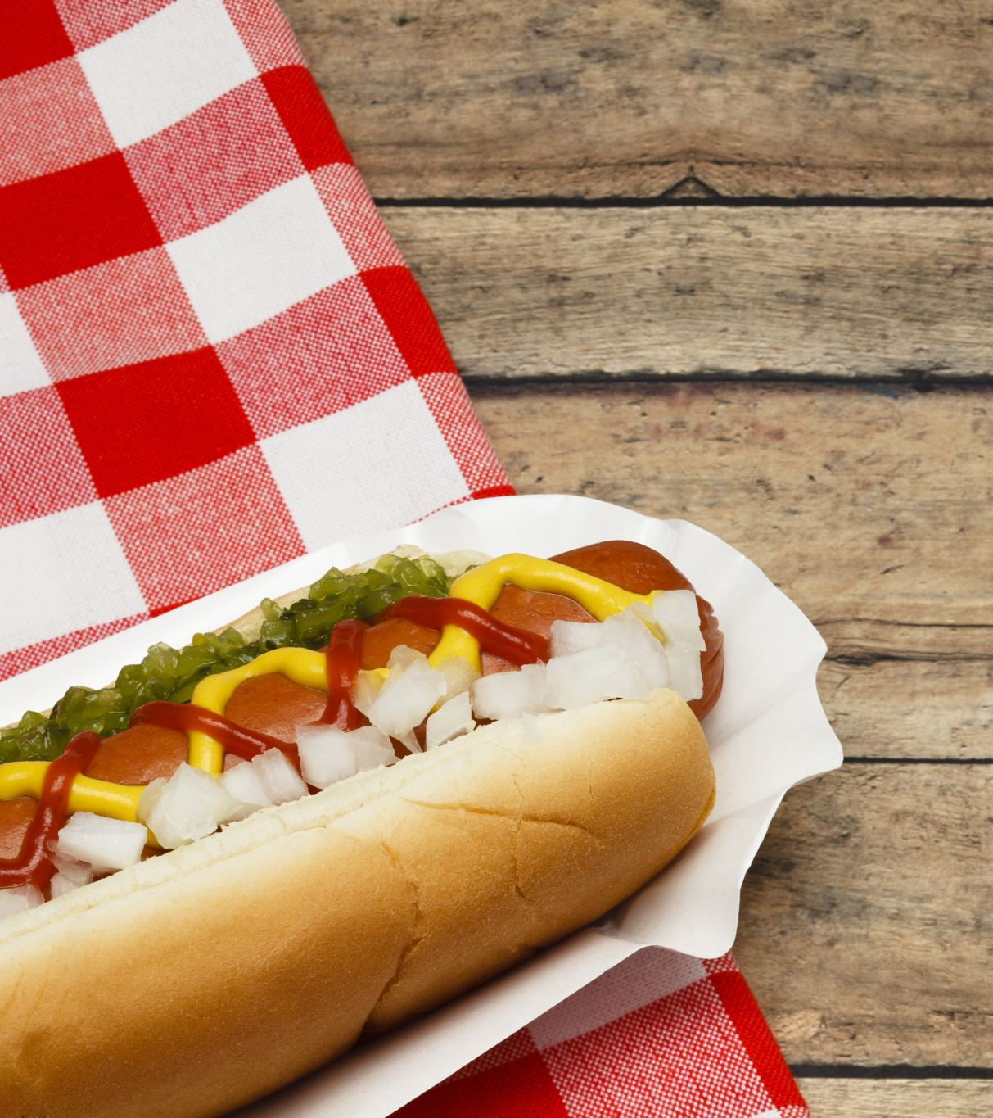
Least Healthy Items
Highest Calories & Fat: - RODEO King™ Sandwich (1300 kcal, 83g fat) - Triple WHOPPER™ (1220 kcal, 82g fat) - Bacon King™ (1200 kcal, 81g fat)

Slide 8
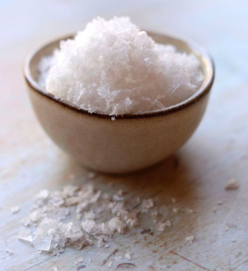
Salt-to-Fat Ratio Analysis
Items with the Highest Salt-to-Fat Ratio:
Ham, Egg, & Cheese Biscuit (70.0 ratio)
Chicken Fries (9pc) (60.0 ratio)
Cheeseburger (60.0 ratio)

Slide 9

Fat-to-Calorie Ratio Analysis
Identifying High-Fat Items Relative to Calories
Mayonnaise (Packet) - 100% fat calories
Ken’s Golden Italian Dressing - 94.7% fat calories
Zesty Onion Ring Dipping Sauce - 93.3% fat calories

Slide 10
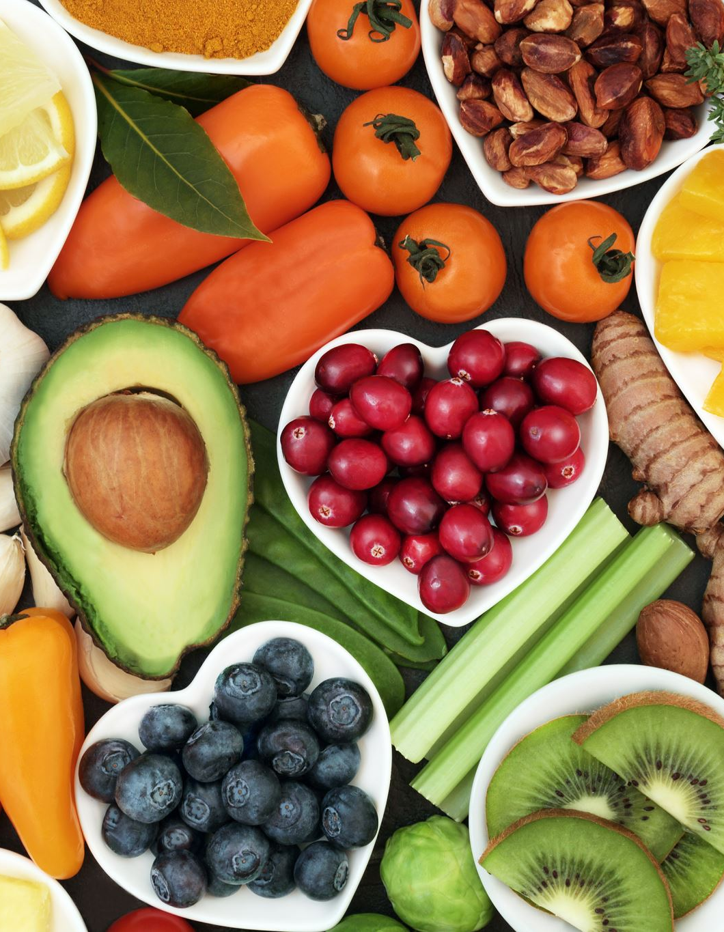
Conclusion
Healthier Menu Suggestions:
Promote high-fiber & low-sodium meals
Offer balanced meal combos
Introduce healthier snack alternatives

Slide 11
Thank You
Q&A Session
Contact Info
Gmail – st.baviskar43@gmail.com
LinkedIn - https://www.linkedin.com/in/sumit-baviskar/

